Slide 1

Spring Boot
Dima Ionut Daniel

Slide 2
Contents
What is Spring Boot?
Architecture
Spring Boot Features
Spring Boot Modules
Spring Boot Core
Web Applications
Database Access
Conclusions
Bibliography

Slide 3

What is Spring Boot?
Spring Boot is a brand new framework from the team at Pivotal
It's designed to simplify the bootstrapping and development of a new Spring application.
It's freeing developers from the need to define boilerplate configuration.
Boot aims to be a front-runner in the ever-expanding rapid application development space.

Slide 4
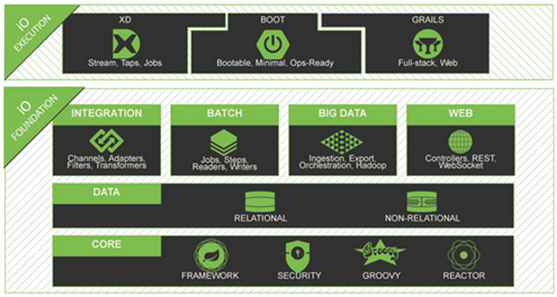
Architecture

Slide 5
Spring Boot Features
Create stand-alone Spring applications.
Embed Tomcat or Jetty directly (no need to deploy WAR files)
Automatically configure Spring whenever possible
Provide production-ready features such as metrics, health checks and externalized configuration
Absolutely no code generation and no requirement for XML configuration
Documented, API and Reference included

Slide 6
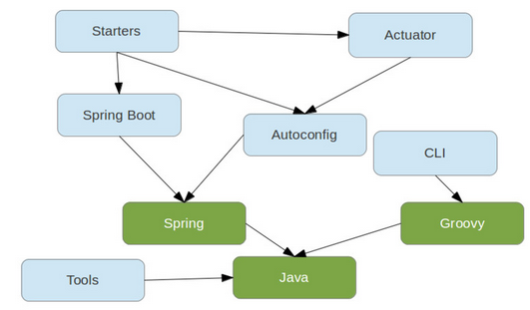
Spring Boot Modules
Spring Boot – main library supporting the other parts of Spring Boot.
Spring Boot Autoconfigure – single @EnableAutoConfiguration annotation creates the Spring context.
Spring Boot Starters – a set of convenient dependency descriptors that we can include.
Spring Boot CLI – compiles and runs Groovy source as Spring application.
Spring Boot Actuator- common non-functional features that make an application instantly deployable and supportable in production.
Spring Boot Tools – for building and executing self-contained JAR and WAR archives.
Spring Boot Samples – wide range of sample application

Slide 7
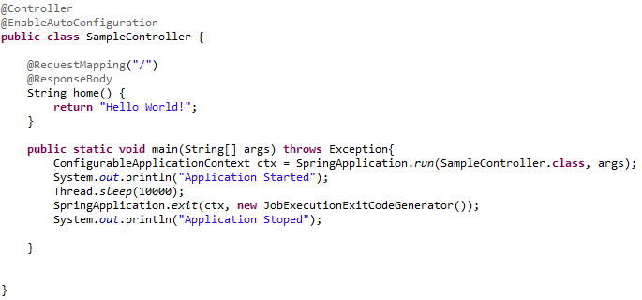
Spring Boot Core
The Spring application can be started/stoped using the SpringApplication class.
The annatations used in bellow example are from Spring MVC/MVCWeb.

Slide 8
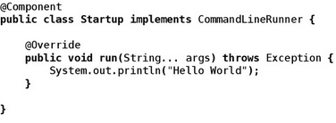
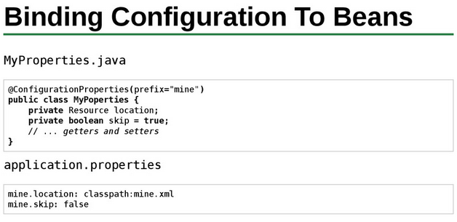
Spring Boot Core (cont.)
CommandLineRunner is a hook up to run application-specific code after the context is created.
We can use @ConfigurationProperties annotation to bind properties into POJO.
The name of the property file can be changed using spring.config.location or spring.config.name.

Slide 9
Spring Boot Core (cont.)
@RestController is a stereotype annotation and provide a hint for Sprintg.
@RequestMapping provides routing information.
@RestController and @RequestMapping annotations are Spring MVC annotations.
@EnableAutoConfiguration tells Spring Boot how to configure Spring.

Slide 10
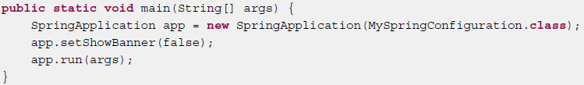
Spring Boot Core (cont.)
The org.springframework.boot.SpringApplication class provides bootstrap capabilities.
The banner that is printed on start up can be changed by using banner.txt in the classpath or setting the banner.location to a file; the encoding of the file can be set using banner.encoding(default UTF-8).
The banner can be hidden/shown at startup using the setShowBanner() method.

Slide 11
Spring Boot Core (cont.)
SpringBoot Application class can register listeners using addListeners() method.
ApplicationStartedEvent is sent at start, but before any processing of listeners and initializers.
ApplicationEnvironmentPreparedEvent is sent when the Environment to be used in the context is known.
ApplicationPreparedEvent is sent before the refresh is started.
ApplicationFailedEvent is sent if there are exceptions on startup.
Each SpringApplication will register a shutdown hook with the JVM to ensure that the ApplicationContext is gracefully closed on exit.
Spring Boot uses Commons Logging for internal logging, but log implemenetation can be overriden.

Slide 12
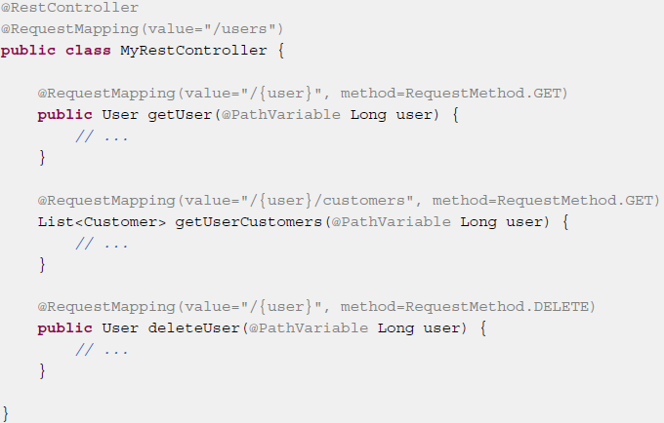
Web Applications
Spring Boot is well suited for web application development.
Spring Boot can use embedded Tomcat or Jetty.
Most web applications will use spring-boot-starter-web module.
Spring MVC uses the model view controller pattern.
Spring MVC can handler HTTP requests using @Controller, @RestController annotations.
Methods from the controller are mapped t HTTP using @RequestMapping annotations.

Slide 13
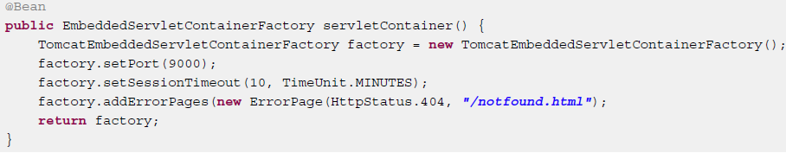
Web Applications (cont.)
Spring MVC can be used to serve dynamic HTML content.
Spring MVC supports a variety of template technologies like: FreeMarker, Groovy, Velocity, Thymeleaf.
We can define custom servlet container properties like: server.port, server.address, server.sessionTimeout.
Customization can be done also programmatically using: TomcatEmbeddedServletContainerFactory or JettyEmbeddedServletContainerFactory.

Slide 14
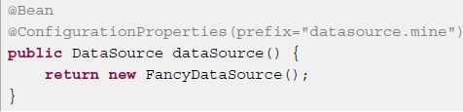

Database Access
The Spring framework provides support for working with SQL databases using the JdbcTemplate pattern.
Spring Boot can auto-configure embedded H2, HSQL and Derby databases.
DataSource configuration is controller by external configuration properties in spring.datasource.*.
Spring Data can work with NoSQL technologies like: MongoDB, Neo4j, Solr, Redis, Gemfire, Couchbase, Cassandra, Elasticsearch.

Slide 15
Conclusions
Spring Based
Documented
Easy to use

Slide 16

Bibliography
https://speakerdeck.com/dsyer/spring-boot-introduction
http://www.infoq.com/articles/microframeworks1-spring-boot
http://projects.spring.io/spring-boot/
Spring-boot-reference

